Slide 1
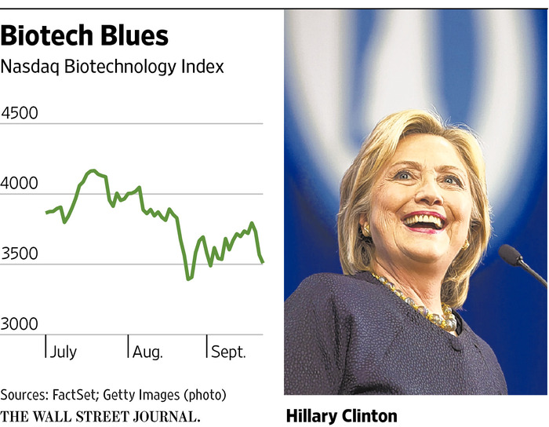
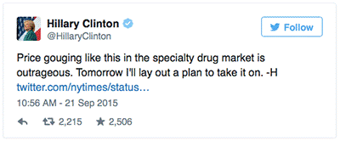
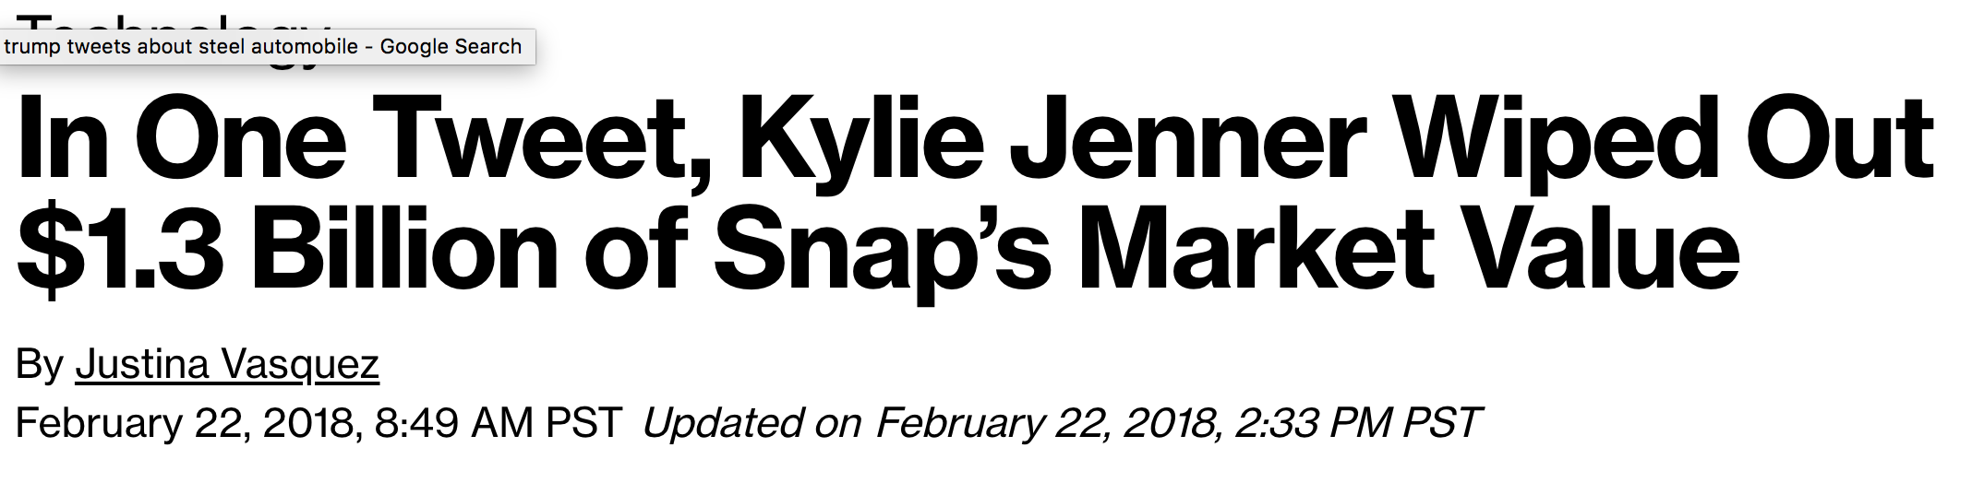
Social Media Influence on Stocks
Notes:
We noticed that celebrities tweet on different companies/stocks and wanted to get a better sense of the impact that they have.
Similar situation with Rihanna, Snapchat stock lost $800 million one month after KJs.
Wanted to see if DJTs Tweets had any effect on stock performance

Slide 2
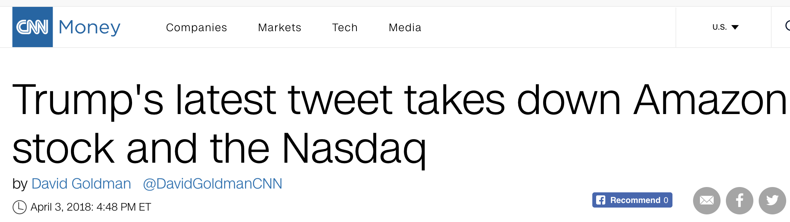
Trump’s Tweets
Notes:
We wanted to have someone that tweets frequently about different companies and who better than trump?
Amazon trump example

Slide 3
Questions We Wanted to Answer

Slide 4
What are the sentiments of Trump’s tweets regarding a certain key terms?
Do these sentiments have any impact on stock markets?
If present, how long do these impacts last?
Which sectors are most impacted by these tweets?
What is the Impact of the # of Likes & Retweets?

Slide 5
Data Sources

Slide 6
Data Sources
Twitter API
Obtained 1 year’s worth of Data
Alpha Vantage API
Yahoo
Nasdaq
Notes:
Set Tweepy API Authentication, using api.user_timeline looped through 160 pages to maximum allowed limit of 3200 tweets
Declared empty lists to hold Tweet Texts, created date, number of retweets, number of likes
Created data-frame out of above lists
Created CSV file to hold keywords
For each keyword looped through extracted tweets to filter and formed new dataframe
Performed sentiment analysis on the filtered data frame
Used Alpha Vantage API for Stock indices Data.
Used Yahoo Finance for sector data (Telecom.
Nasdaq
PHLX Semiconductor (^SOX)
PHLX Oil Service Sector (^OSX)
PHLX Housing Sector (^HGX)
PHLX Utility Sector (^UTY)
NASDAQ Bank (^BANK)
NASDAQ Industrial (^INDS)
NASDAQ Insurance (^INSR)
NASDAQ HealthCare (^IXHC)
NASDAQ Telecommunications (^IXTC)
NASDAQ Biotechnology (^NBI)
# 1. Banking
# 2. Biotechnology Sector
# 3. Healthcare Sector
# 4. Housing Sector
# 5. Industrials Sector
# 6. Insurance Sector
# 7. Oil & Gas Sector
# 8. Semiconductor Sector
# 9. Telecom Sector
#10. Utility Sector

Slide 7
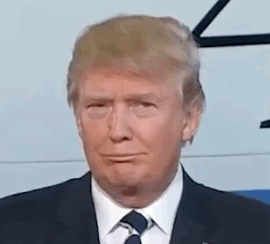
Narrowing The Scope
Filtered By Keyword
Tariffs, Taxes… etc..
Ran Sentiment Analysis and focused on the two extremes
Decided on stock Indexes
Notes:
Will probably get rid of this…
We need one slide that shows how we determined the scope of our project.
Why we decided to use the sentiment analysis
How we decided what keywords to filter by
How we decided to just focus on the extremes
We ended up with 1 year worth of data…
Break show how many tweets there were..

Slide 8
List of Key Words for Filtering the tweets
earnings | corporate | trading | nuclear
futures | sanctions | unemployment | wages
investor | tariff | wall street | buy America
market | tax | china | hire America
Nasdaq | jobs | ban | build
North Korea | economy | bull | factories
stock | trade | Kim | labor
market | missile | price
Expanded the list of key words
Dropped certain key words
The choice of key words impacts the quality of filtered data set and analysis…..
Notes:
Set Tweepy API Authentication, using api.user_timeline looped through 160 pages to maximum allowed limit of 3200 tweets
Declared empty lists to hold Tweet Texts, created date, number of retweets, number of likes
Created data-frame out of above lists
Created CSV file to hold keywords
For each keyword looped through extracted tweets to filter and formed new dataframe
Performed sentiment analysis on the filtered data frame
Used Alpha Vantage API for Stock indices Data.
Used Yahoo Finance for sector data (Telecom.
Nasdaq
PHLX Semiconductor (^SOX)
PHLX Oil Service Sector (^OSX)
PHLX Housing Sector (^HGX)
PHLX Utility Sector (^UTY)
NASDAQ Bank (^BANK)
NASDAQ Industrial (^INDS)
NASDAQ Insurance (^INSR)
NASDAQ HealthCare (^IXHC)
NASDAQ Telecommunications (^IXTC)
NASDAQ Biotechnology (^NBI)
# 1. Banking
# 2. Biotechnology Sector
# 3. Healthcare Sector
# 4. Housing Sector
# 5. Industrials Sector
# 6. Insurance Sector
# 7. Oil & Gas Sector
# 8. Semiconductor Sector
# 9. Telecom Sector
#10. Utility Sector

Slide 9
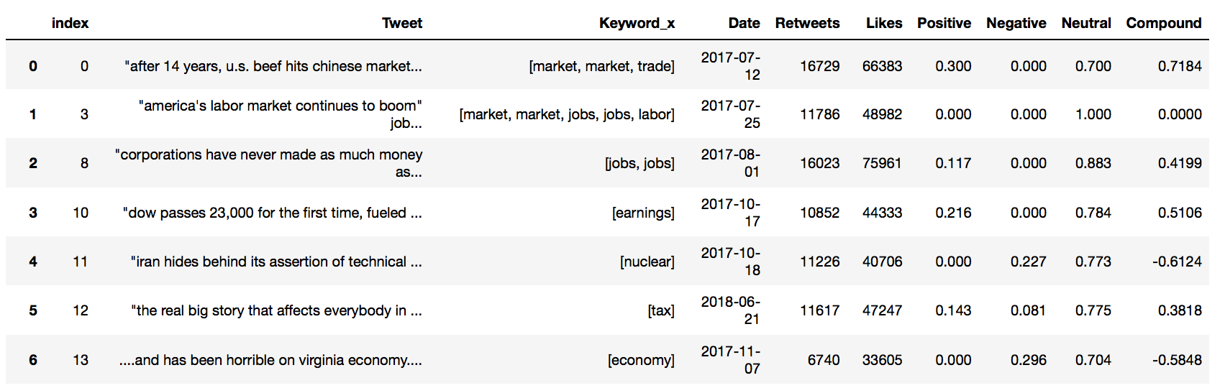
What are the sentiments of Trump’s tweets regarding a certain key terms?
Notes:
Main criteria was compound score.
Rashim will show different scenarios later on.

Slide 10
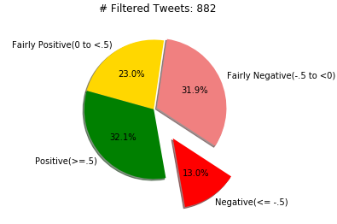
Filtered Tweets
Notes:
Remember to ask the question about sentiments again…
882 was the number of tweets when I ran this on 04/02
Can change based on keywords

Slide 11
Further Filtered Tweets – Based on Different Criterion to Get Different Data Sets for Comparison with Stock Market Analysis
Criteria 1 | Extreme Compound Score >= 0.5 and <= -0.5
Criteria 2 | Negative Score > 0.1
Criteria 3 | Positive Score > 0.1
Criteria 4 | Number of Likes
Criteria 5 | Number of Retweets
Criteria 6 | Revised method of filtering tweets
The choice of the criteria impacts the filtered data set and analysis……

Slide 12
Stock Market Analysis
Stock Indices | Sector Indices | API / CSV Data | Analysis
S&P 500 | # 1. Banking | Opening Price | % Same day change in price
Nasdaq | # 2. Biotechnology | Closing Price | % One day / next day change in price
Dow Jones | # 3. Healthcare |  | % Two day change in price
 | # 4. Housing
 | # 5. Industrials
 | # 6. Insurance
 | # 7. Oil & Gas
 | # 8. Semiconductor
 | # 9. Telecom
 | #10. Utility

Slide 13
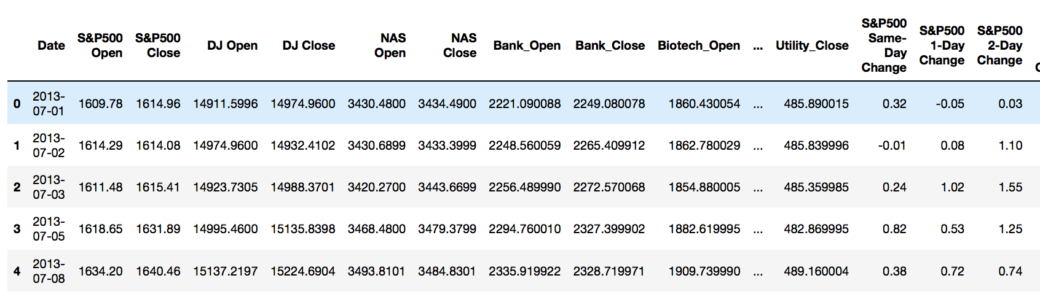
Stock Market Analysis

Slide 14
Statistical Analysis
Twitter Sentiment Analysis Data
Stock Market Analysis Data
Set 1 - Compound Sentiment Score
Set 2 - Negative Sentiment Score
Set 3 - Positive Sentiment Score
Set 4 – Number of Likes
Set 5 – Number of Retweets
Set 6 – Revised Criteria
Stock Index Performance
Same day change
Next day change
Two day change
Correlation
Sector Performance
Same day change
Next day change

Slide 15
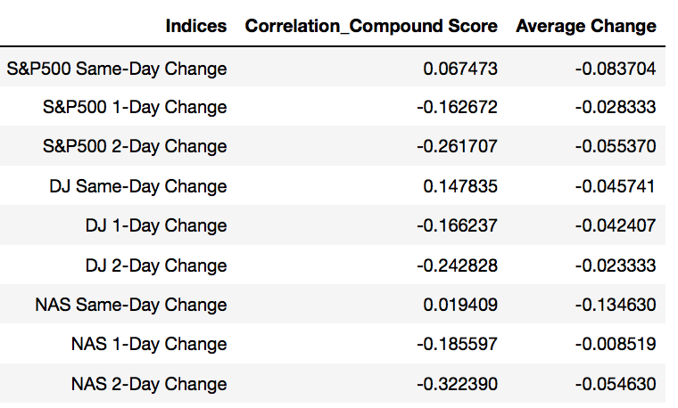
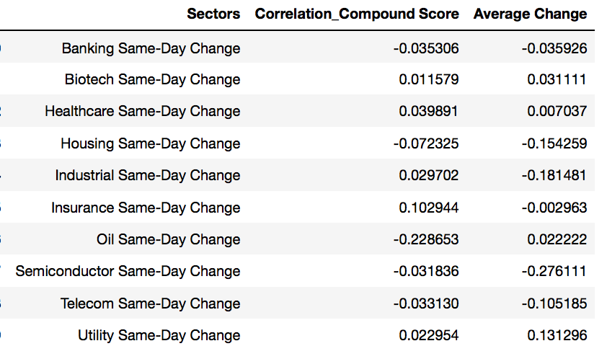
Statistical Analysis

Slide 16
Our Findings
Notes:
Do these sentiments have any impact on stock markets concerning these key terms?
If present, how long do these impacts last?

Slide 17
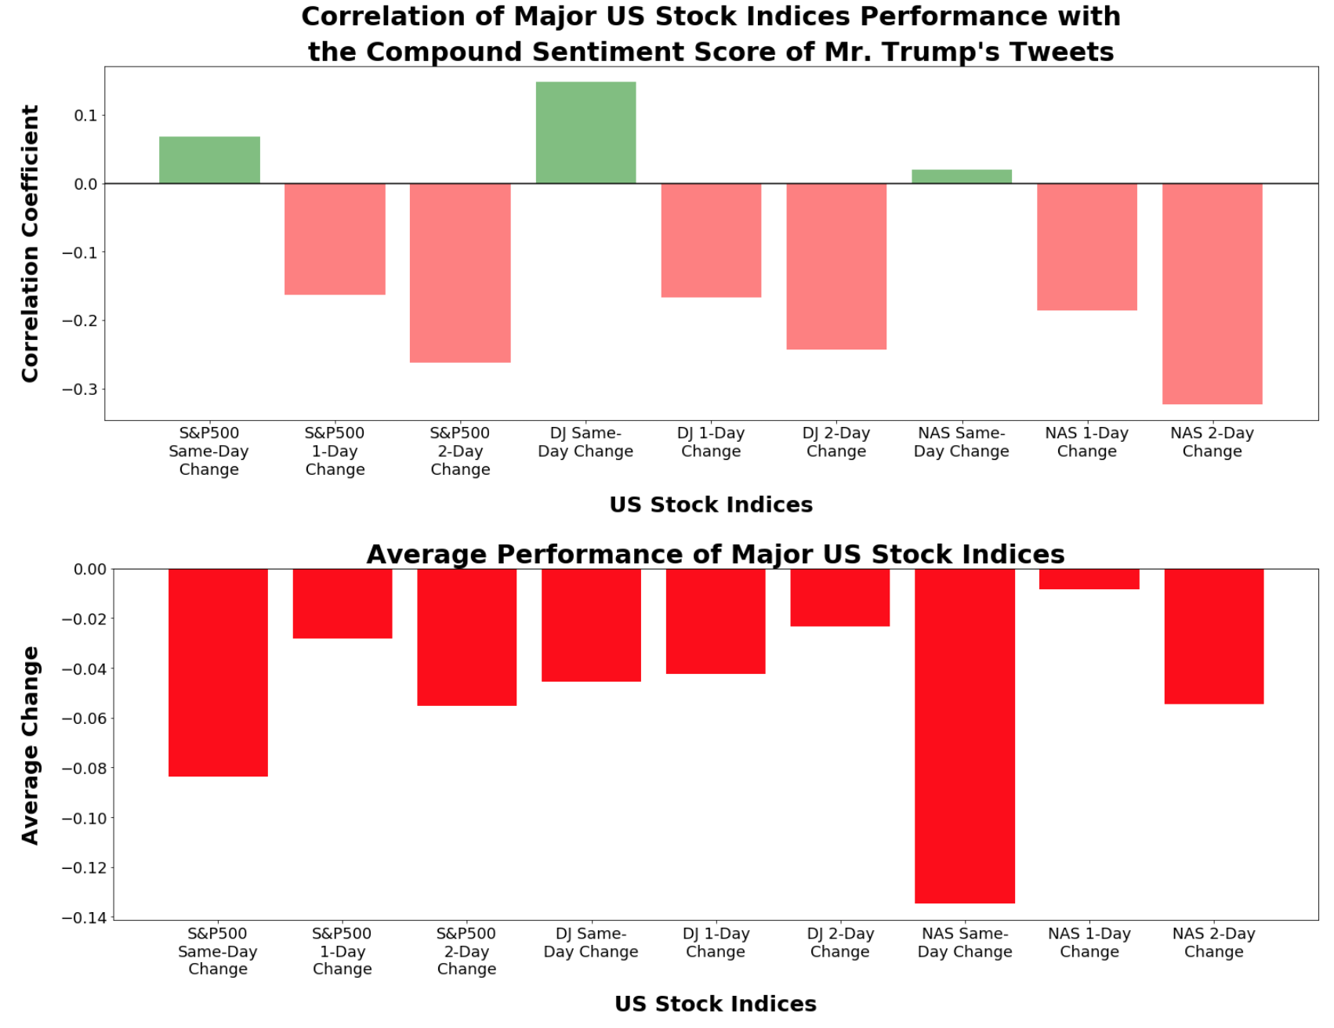
1.Compound Sentiment Score vs. Stock Indices Performance
The bars in Green color show the positive correlation between same day stock index performance and compound sentiment score of Mr. Trump’s tweets.
Notes:
Remember to answer impact question…

Slide 18
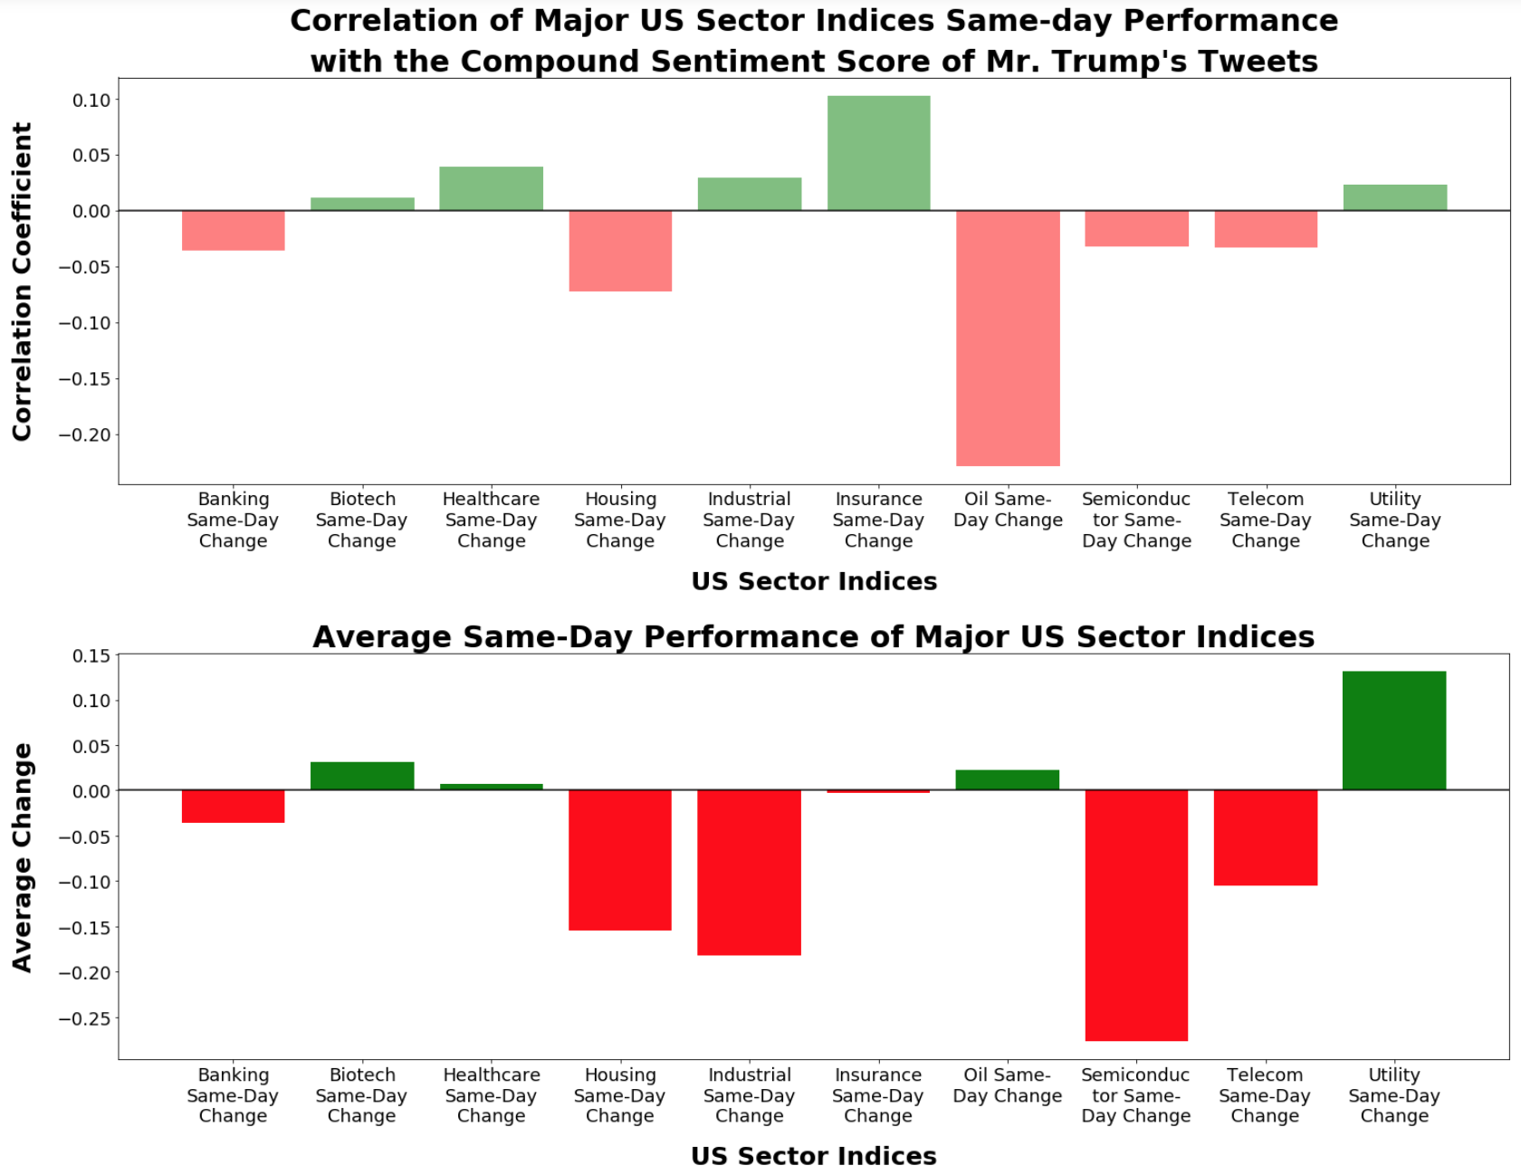
2. Compound Sentiment Score vs. Sector Performance<= -.5)]
The bars in Green color show the positive correlation between same day sector performance and compound sentiment score of Mr. Trump’s tweets.
We found positive correlation for Biotech, Healthcare, Industrials, Insurance and Utility sectors.

Slide 19
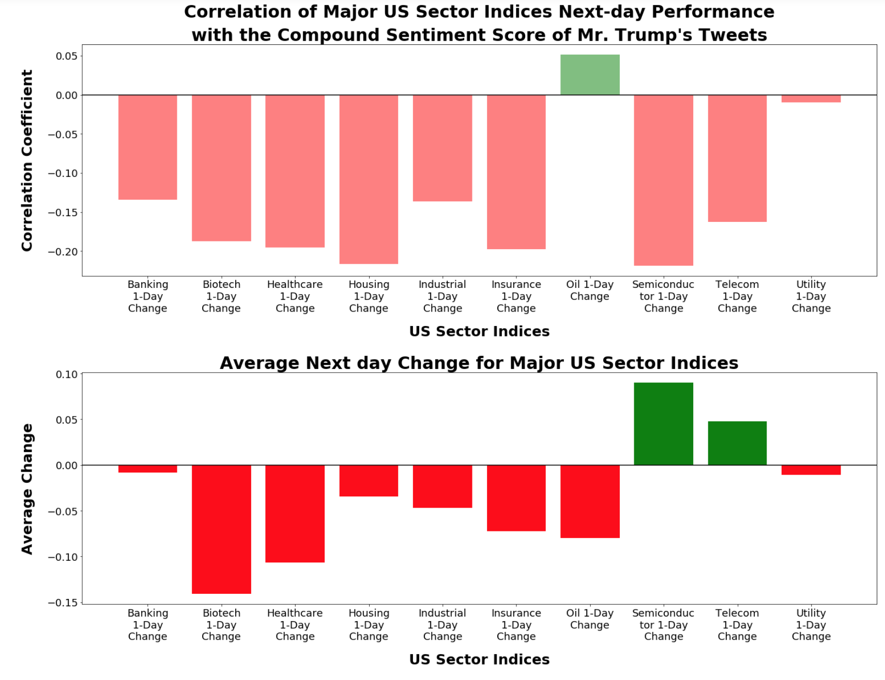
2.1- Based on Compound Sentiment Score vs. Sector Performance
We found no positive correlation between one day sector performance and Mr. Trump’s Tweets for most sectors.

Slide 20
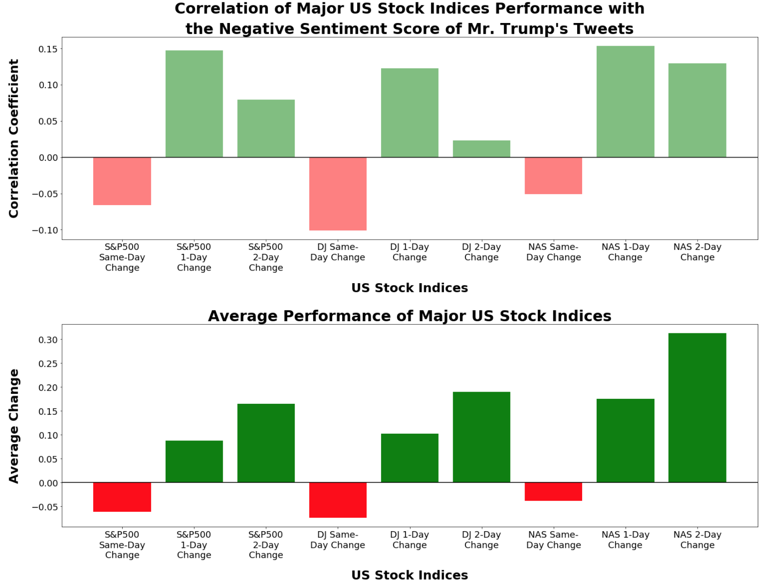
3. Negative Sentiment Score vs. Stock Indices Performance
The bars in Green color show the positive correlation between next day and two day stock index performance and negative sentiment score of Mr. Trump’s tweets.

Slide 21
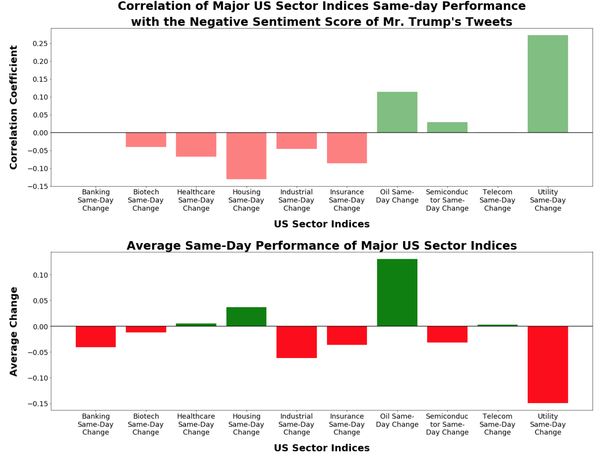
4. Based on Negative Sentiment Score vs. Sector Performance
The bars in Green color show the positive correlation between same day sector performance and negative sentiment score of Mr. Trump’s tweets.
We found positive correlation for Oil &Gas, Semiconductors and Utility sectors.
Notes:
Breeze through these

Slide 22
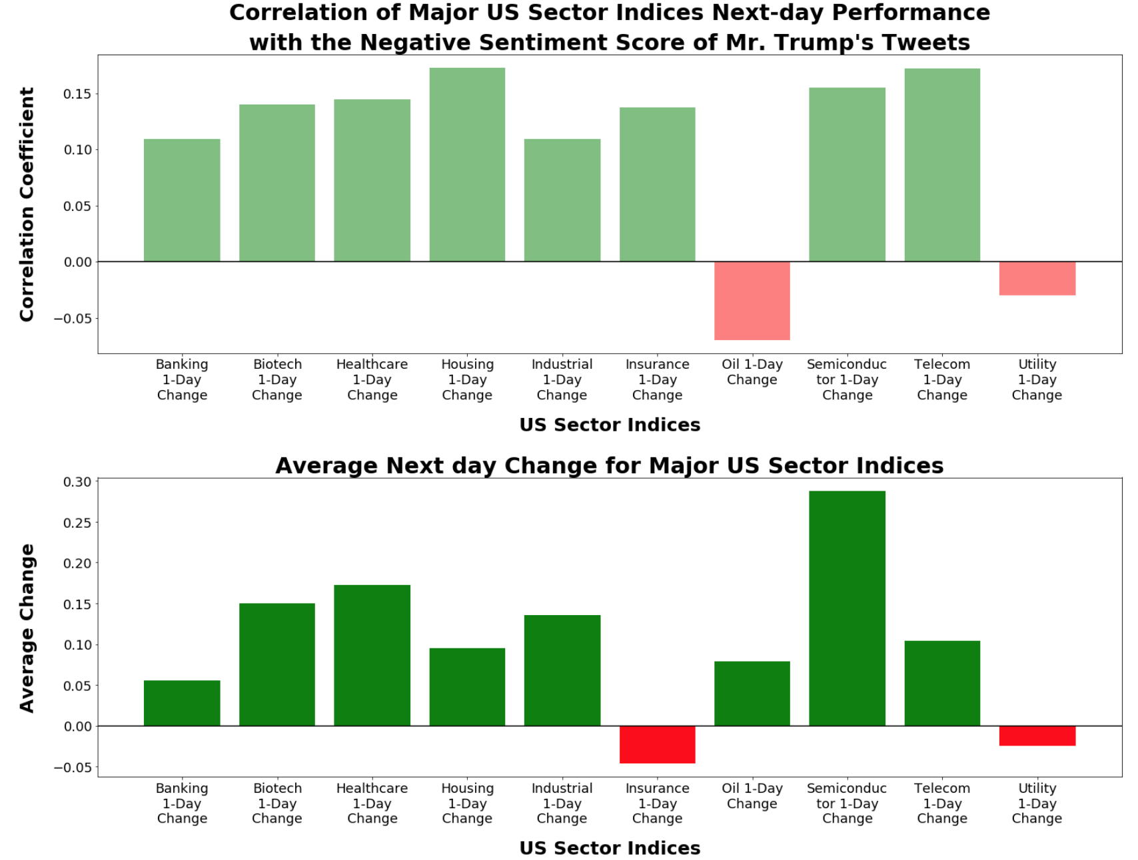
4.1 Based on Negative Sentiment Score and Sector performance
We found positive correlation between one day sector performance and Mr. Trump’s Tweets for most sectors.
Notes:
Breeze through these

Slide 23
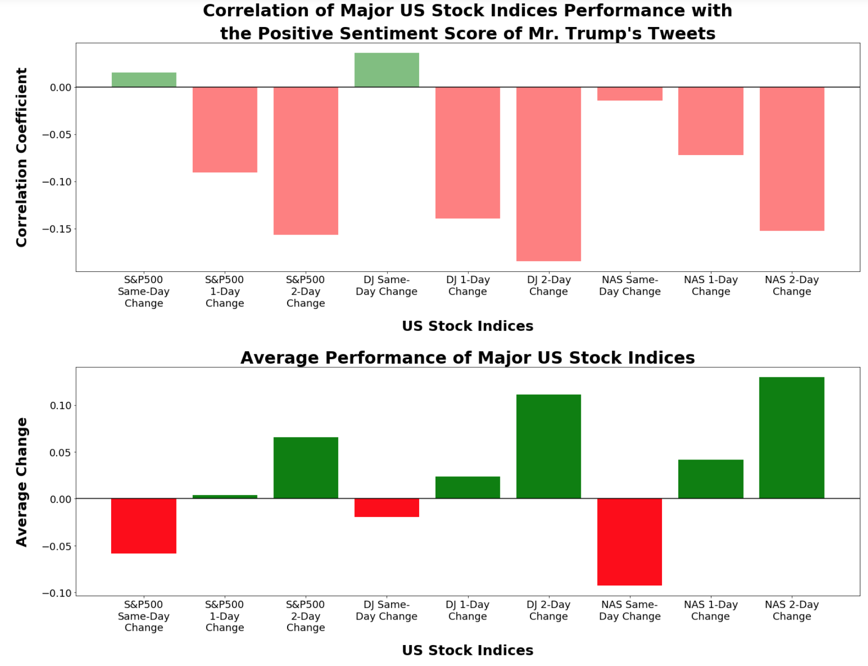
5. Based on Positive Sentiment Score vs. Stock Indices Performance
The bars in Green color show the positive correlation between same day stock index performance and positive sentiment score of Mr. Trump’s tweets.
Notes:
Breeze through these

Slide 24
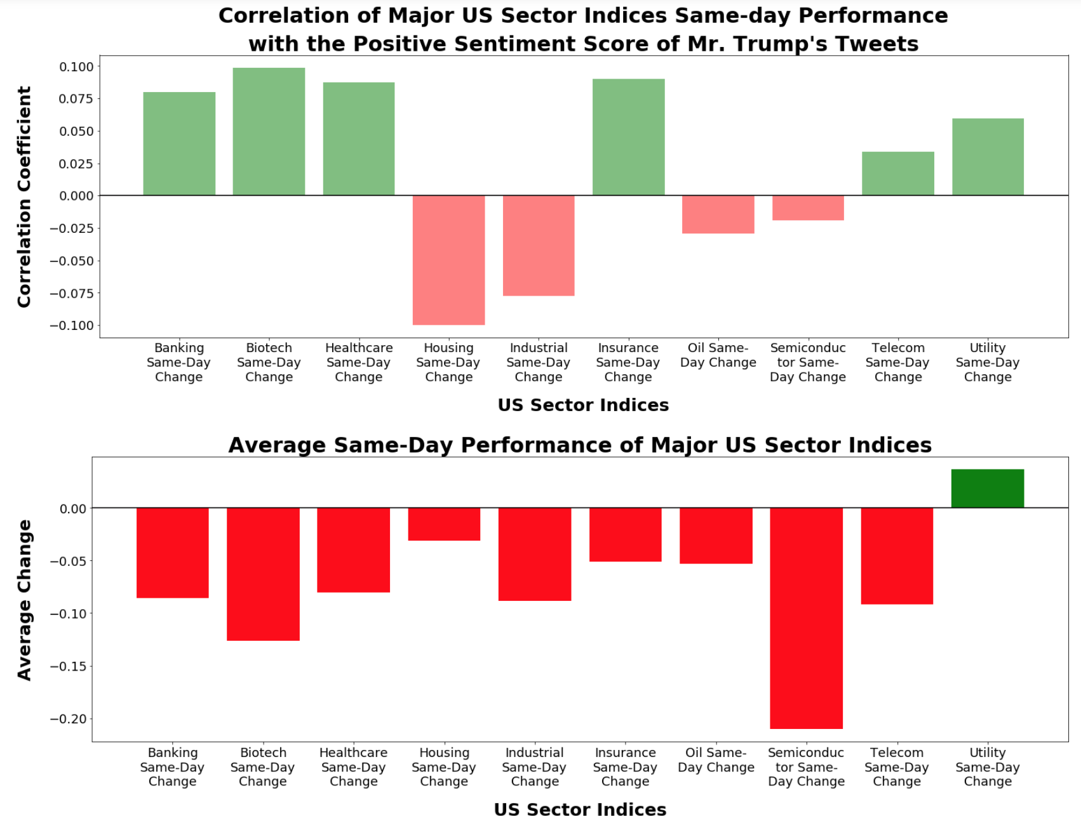
6. Based on Positive Sentiment Score vs. Sector Performance
The bars in Green color show the positive correlation between same day sector performance and positive sentiment score of Mr. Trump’s tweets.
We found positive correlation for Banking, Biotech, Healthcare, Insurance, Telecom and Utility sectors.
Notes:
Breeze through these

Slide 25
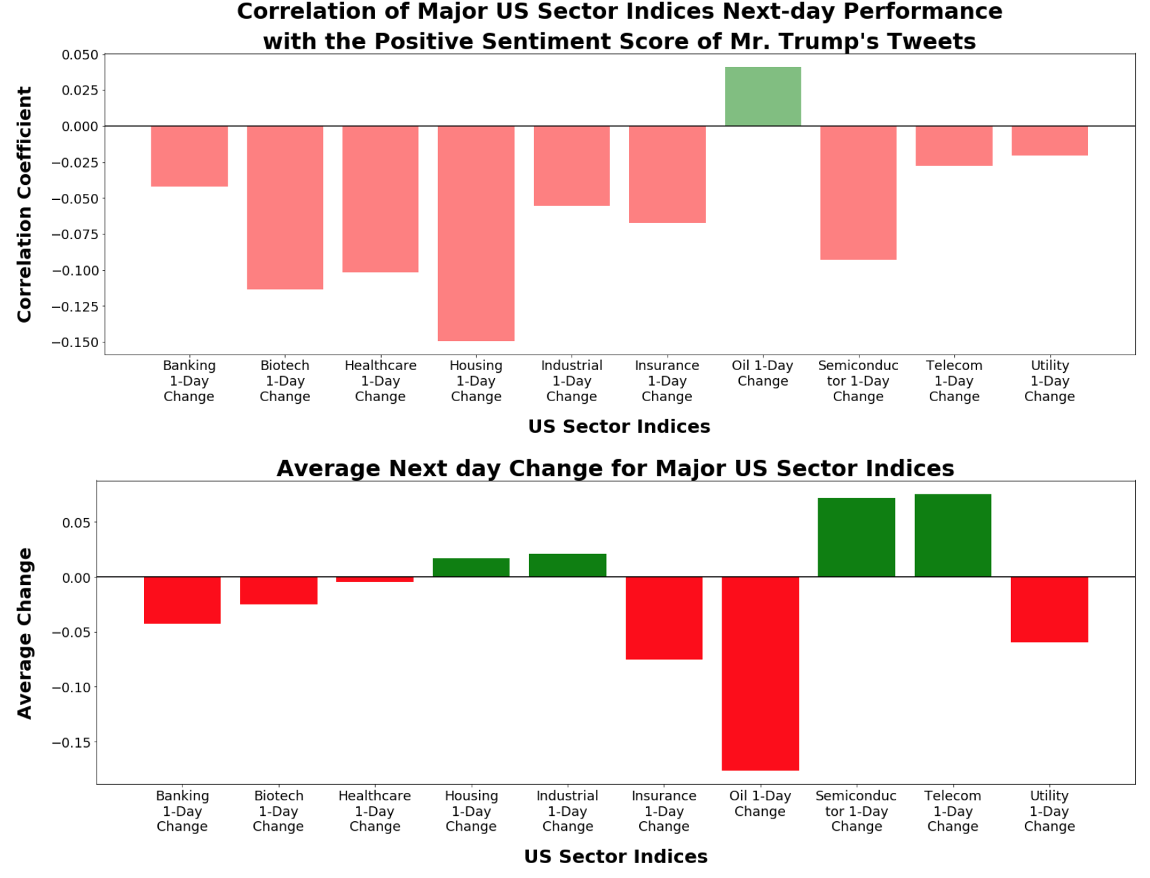
6.1 Based on Positive Sentiment Score vs. Sector Performance
We found no positive correlation between one day sector performance and Mr. Trump’s Tweets for most sectors.
Notes:
Breeze through these

Slide 26
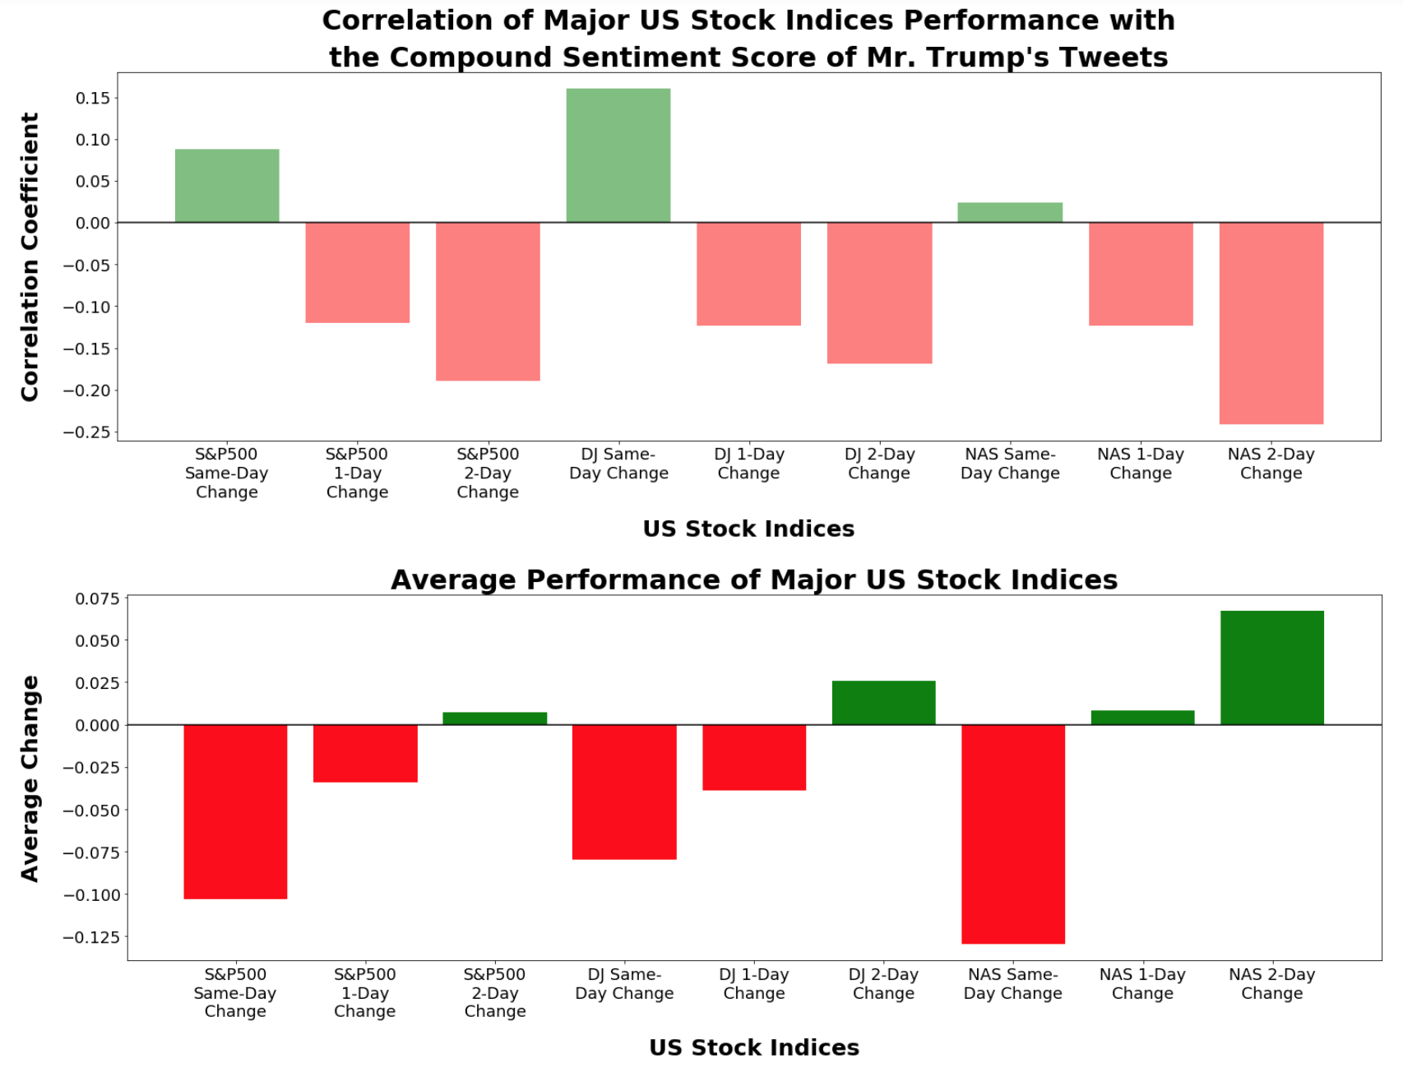
7. Based on Revised Compound Score vs. Stock Indices Performance
The bars in Green color show the positive correlation between same day stock index performance and compound sentiment score of Mr. Trump’s tweets.
We also noticed higher correlation scores compared to our initial compound score analysis findings.
Notes:
Breeze through these

Slide 27
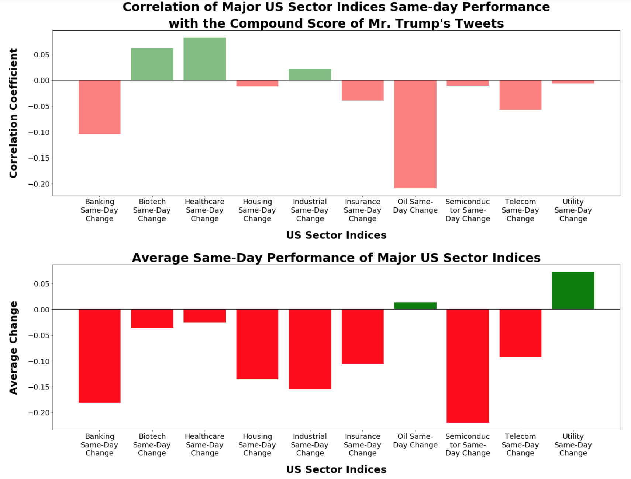
8. Revised Compound Score vs. Sector Performance
The bars in Green color show the positive correlation between same day sector performance and compound sentiment score of Mr. Trump’s tweets.
We also noticed higher correlation scores compared to our initial compound score analysis findings.
Notes:
Breeze through these

Slide 28
What about Likes and Retweets?
Notes:
Do these sentiments have any impact on stock markets concerning these key terms?
If present, how long do these impacts last?

Slide 29
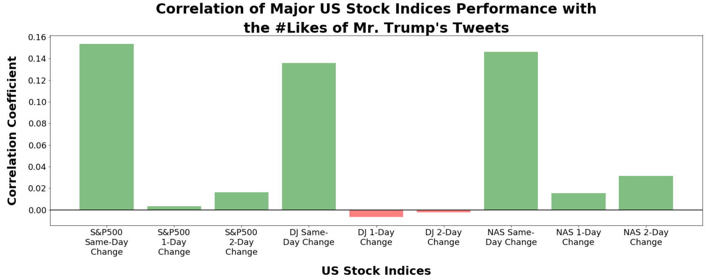
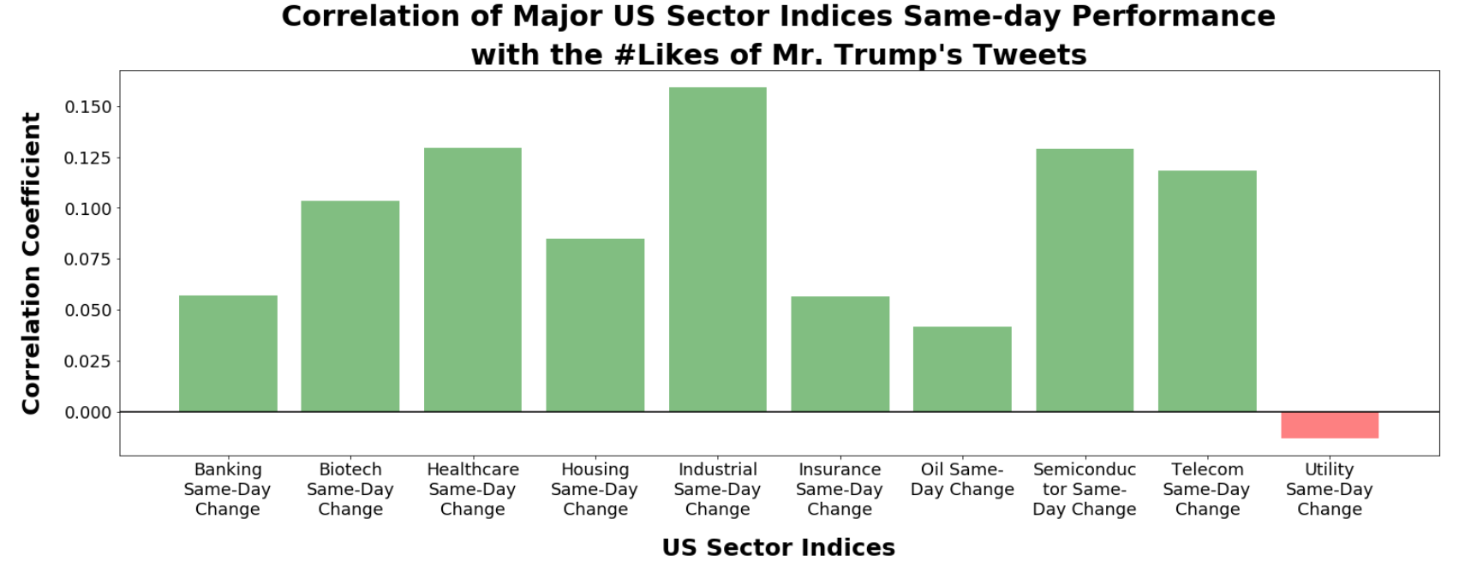
Correlation Based on Likes
The bars in Green color show the positive correlation between same day stock index performance and # of Likes from Mr. Trump’s tweets.

Slide 30
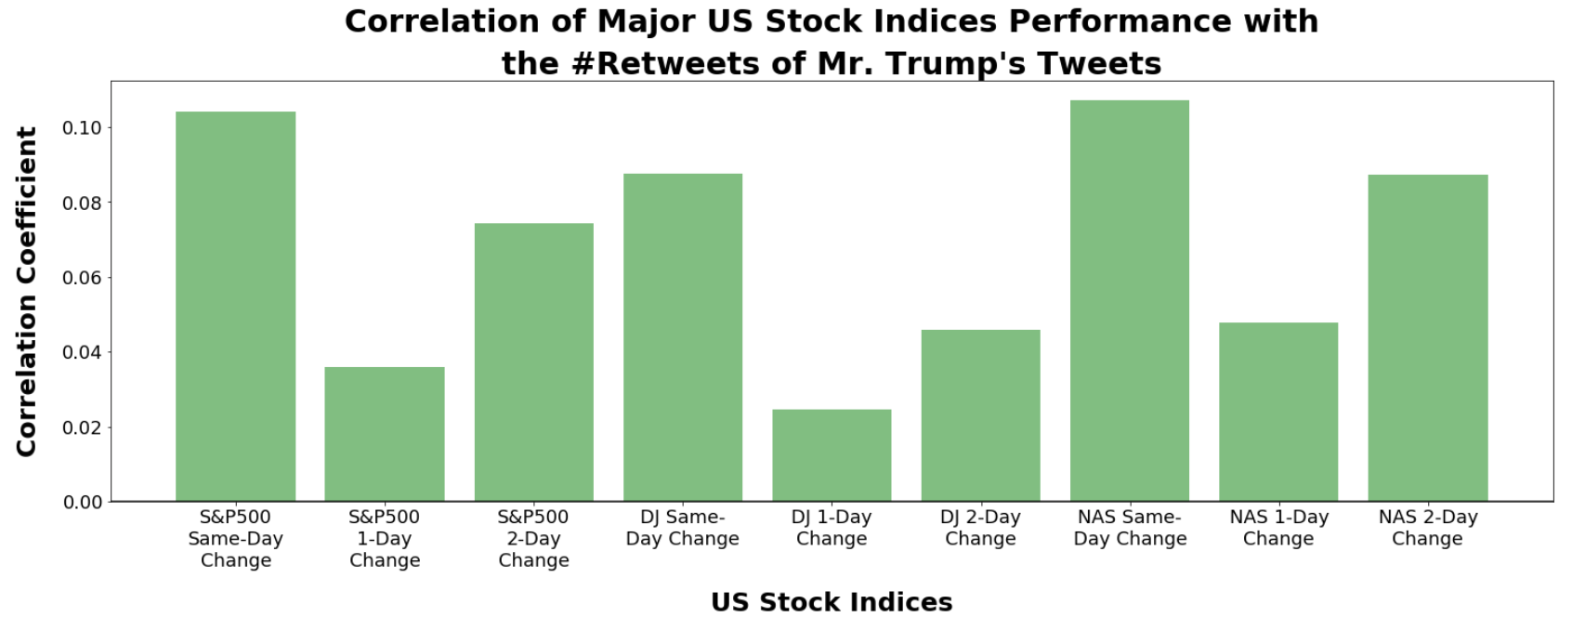
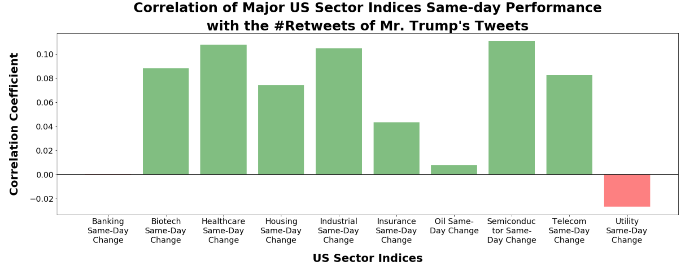
Correlation Based on #Retweets
The bars in Green color show the positive correlation between same day stock index performance and # of Retweets from Mr. Trump.

Slide 31
Our Other Interesting Findings

Slide 32
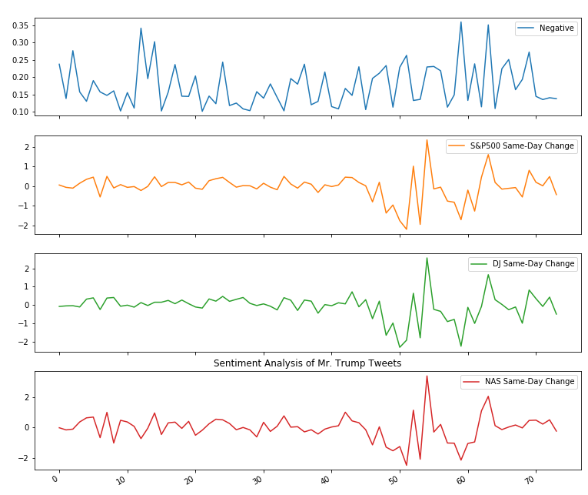
9. Negative Sentiment Score vs. Stock Index Performance
Notes:
How the sectors behave base on negative score and not compound score….. From analysis
X Represents the occurrence #

Slide 33
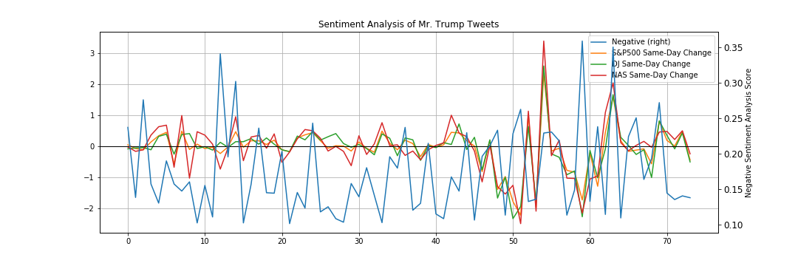
10. Negative Sentiment Score vs. Stock Index Performance
Notes:
Blue line is the analysis values for negative scores.
There is a slight correlation…

Slide 34
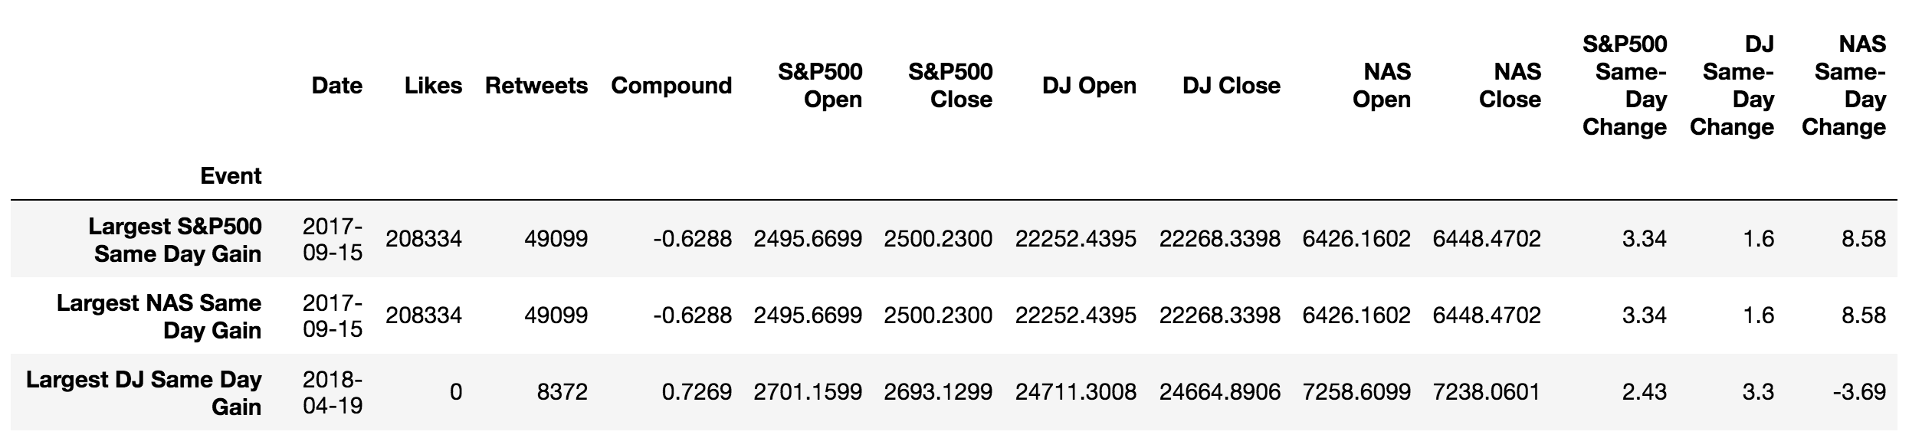
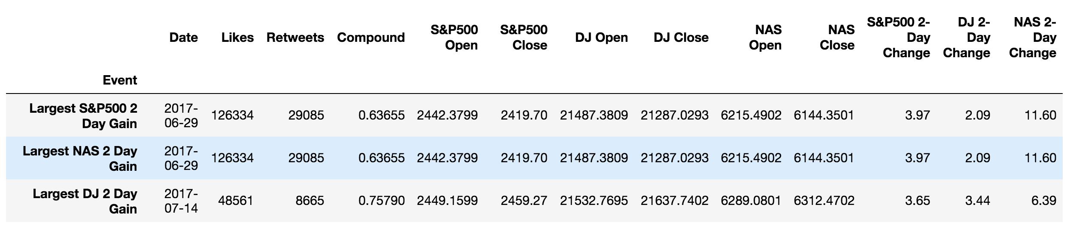
Largest Gains
Same Day
Two Day
Notes:
SP 500 and Nasdaq shared same max gains and loses days.
Notice the compound score on same day.. The one that Is negative..

Slide 35
Largest Gains Tweets
Sep 15, 2017 06:20:08 AM ESPN is paying a really big price for its politics (and bad programming). People are dumping it in RECORD numbers. Apologize for untruth! (+3.34% NASDAQ same day)
Sep 15, 2017 05:54:14 AM The travel ban into the United States should be far larger, tougher and more specific-but stupidly, that would not be politically correct! (+3.34% NASDAQ same Day)
Jun 29, 2017 08:44:01 PM Just finished a very good meeting with the President of South Korea. Many subjects discussed including North Korea and new trade deal! (+11.6% NASDAQ Two Day)
Jun 29, 2017 06:09:01 PM When it comes to the future of America’s energy needs, we will FIND IT, we will DREAM IT, and we will BUILD IT.… (+11.6% NASDAQ Two Day)
Notes:
All of these tweets happened when the market wasn’t even opened. And some don’t even have to do with business things.

Slide 36
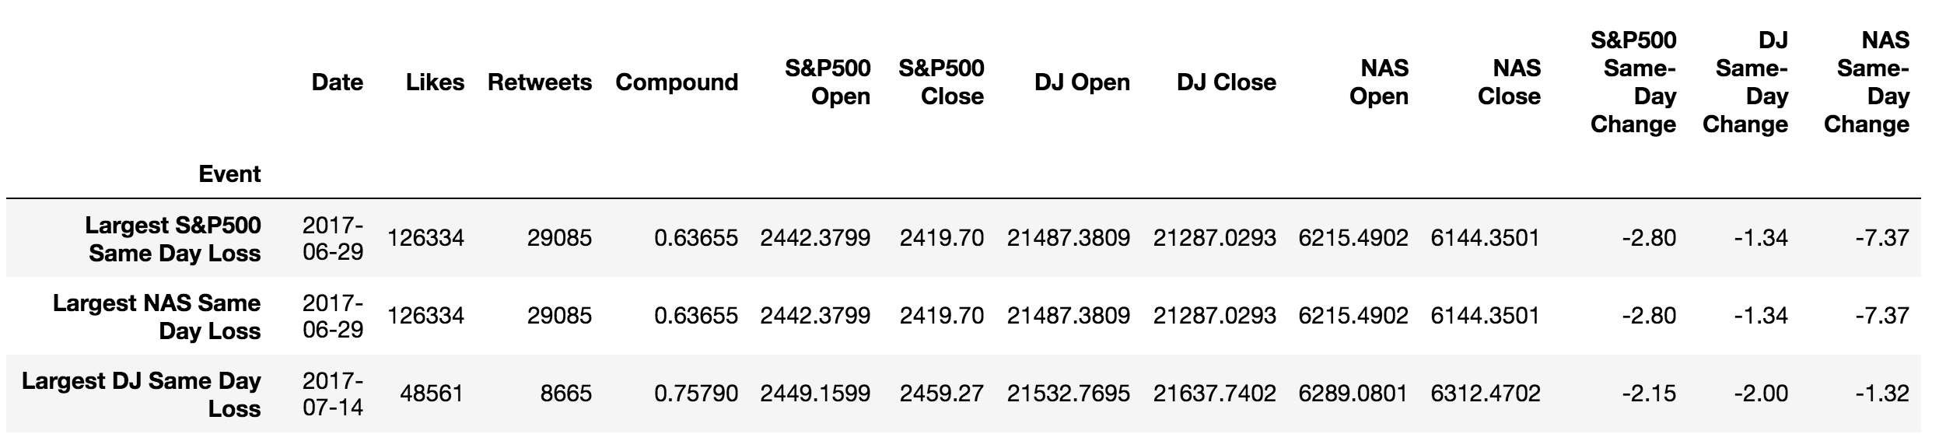
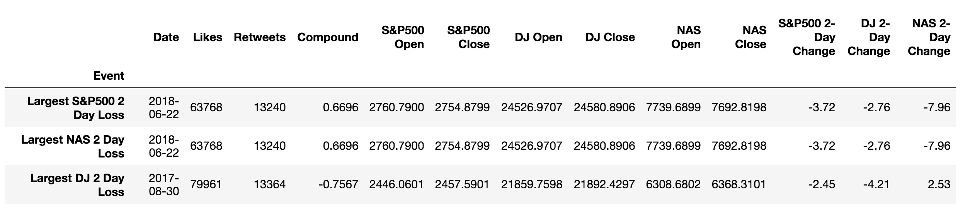
Largest Losses
Same Day
Two Day
Notes:
Have to redo two day labels

Slide 37
Largest Losses Tweets
Jul 14, 2017 08:47:19 AM Great conversations with President @EmmanuelMacron and his representatives on trade, military and security. (-2% Dow Jones)
Aug 30, 2017 08:42:20 AM Will be leaving for Missouri soon for a speech on tax cuts and tax reform - so badly needed! (-4.21% Dow Jones)
Jun 22, 2018 07:34:33 PM Based on the Tariffs and Trade Barriers long placed on the U.S. & its great companies and workers by the European Union, if these Tariffs and Barriers are not soon broken down and removed, we will be placing a 20% Tariff on all of their cars coming into the U.S. Build them here! (-2.76% Dow Jones)
Jun 22, 2018 09:10:07 AM Hope OPEC will increase output substantially. Need to keep prices down! (-2.76% Dow Jones)
Notes:
All of these tweets happened when the market wasn’t even opened. And some don’t even have to do with business things.

Slide 38
SUMMARY

Slide 39
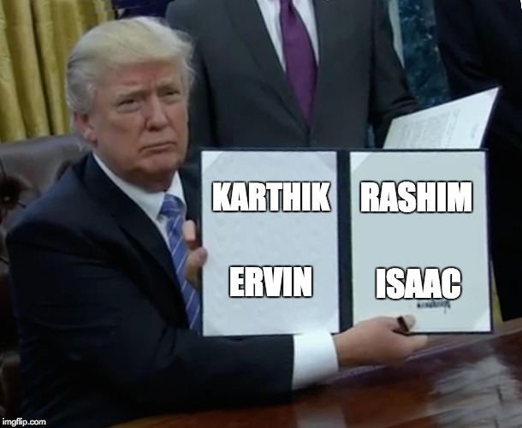
Questions?
Notes:
Ending slide – questions….

